Slide 1
Cloud-native Concepts
November 2018

Slide 2
Outline
Definition of Cloud-native Concepts
Microservice
Container and Container Registry
Kubernetes
OpenShift
Labs
Creating a Docker Container
Using a Docker Registry
Summary

Slide 3
Introduction into the Topic

Slide 4
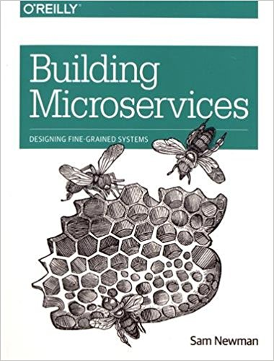
What is a Microservice (Architecture)?
Architectural style that structures an application as a collection of loosely coupled services
Services are fine-grained and their protocols are lightweight
Improves modularity and makes the application easier to understand, develop, and test
Parallelizes development by enabling small autonomous teams to develop, deploy and scale their respective services independently
Individual service emerge through continuous refactoring
Microservices-based architectures enable continuous delivery and deployment
Building Microservices:
Designing Fine-Grained Systems
Sam Newman

Slide 5
Outlook to Developing Microservices Module
Tomorrow:
same time, same place, same topic
BUT
Deep Dive into developing a Microservice

Slide 6
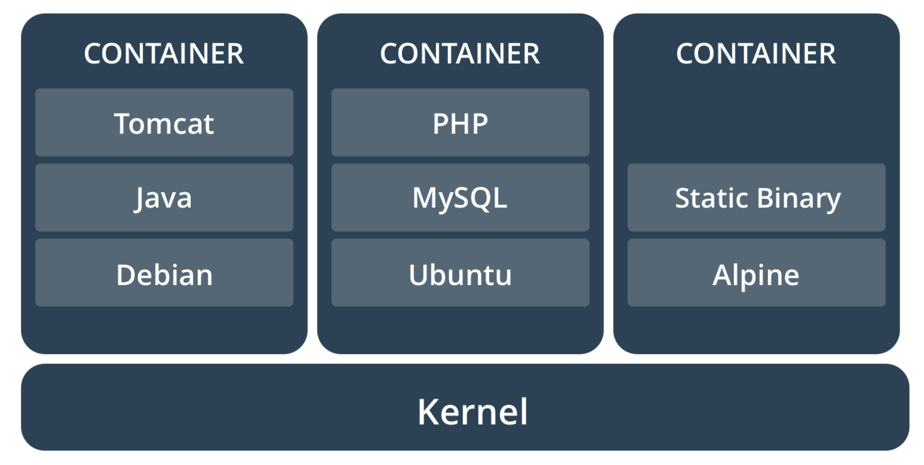
What is a Container Image?
A container image is a lightweight, stand-alone, executable package of software that includes everything needed to run it: code, runtime, system tools, system libraries, settings.

Slide 7
Comparing Containers and Virtual Machines
Containers and virtual machines have similar resource isolation and allocation benefits, but function differently because containers virtualize the operating system instead of hardware. Containers are more portable and efficient.

Slide 8
What is a Container Registry?
In a Container Registry you can store, manage, and secure your Docker container images.
Contrainer Registry Features:
Vulnerability Scanning
Container Tags
Automated Build Triggers

Slide 9
Pull/Push images from/to a Container Registry
Step 1/4: Build the image:
$ sudo docker build -t acm-workshop/hello-world:latest .
Step 2/4: Tag the image:
$ sudo docker tag tag acm-workshop/hello-world:latest acm-workshop/hello-world:0.0.1
Step 3/4: Push the image to the Container Registry:
$ sudo docker push acm-workshop/hello-world:latest
Step 4/4: Pull the image from the Container Registry:
$ sudo docker pull acm-workshop/hello-world:latest

Slide 10
Lab: Working with Container Images and Containers
Overview
Learn how to create a container image
Run a container based on the image
Pull an image from a global container registry
Instructions:
Lab: 1_Working_with_Containers
Takeaways
Get familiar with the concept of containers

Slide 11

What is Kubernetes?
Kubernetes is an open-source system for automating deployment, scaling, and management of containerized applications
MASTER NODE
Kubernetes API
…
WORKER NODE 1
WORKER NODE 2
WORKER NODE 3
kubelet
kubelet
kubelet
…
…
…

Slide 12
Features of Kubernetes
Automatic binpacking
Self-healing
Horizontal Scaling
Service discovery and load balancing
Automated rollouts and rollbacks
Secret and configuration management
Storage orchestration
Batch execution

Slide 13

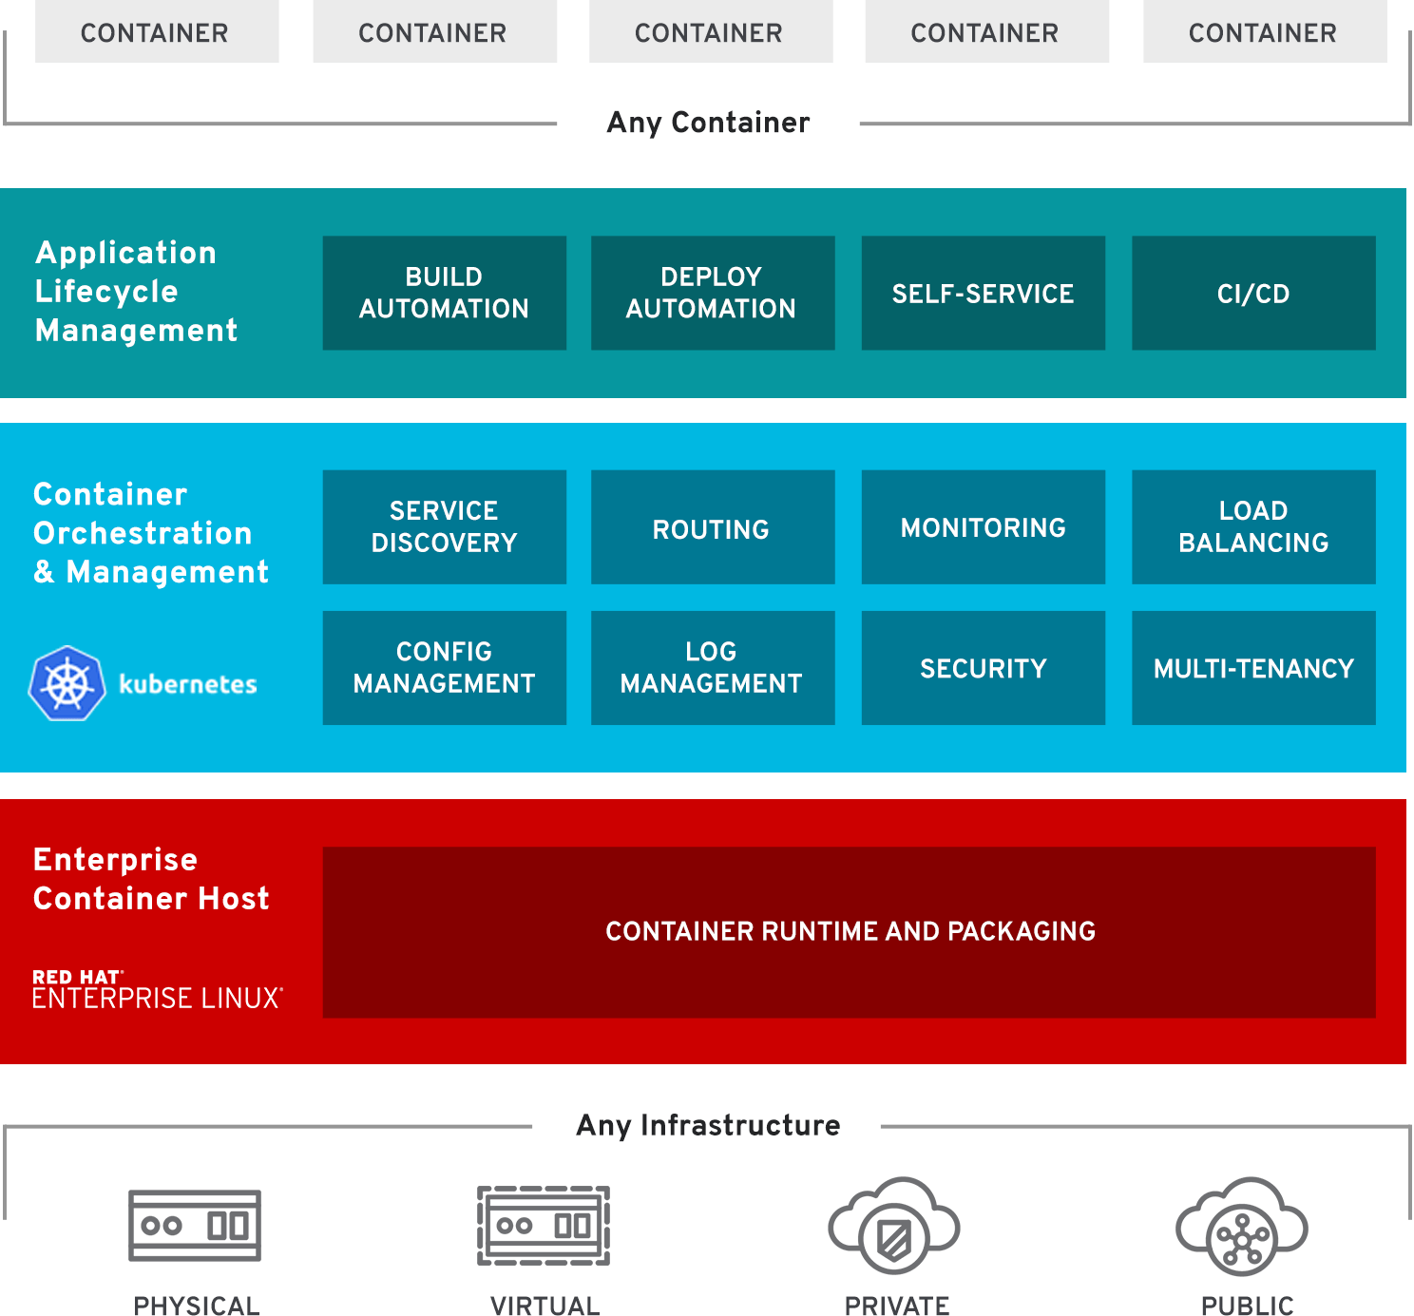
What is OpenShift Origin?
Red Hat OpenShift Origin is an open source container application platform based on the Kubernetes container orchestrator for enterprise application development and deployment
Automate the build, deployment, and management of applications
Source: https://www.openshift.com/learn/what-is-openshift/
Notes:
https://www.openshift.com/learn/what-is-openshift/

Slide 14
Cloud-native Concepts
November 2018

